Slide 1
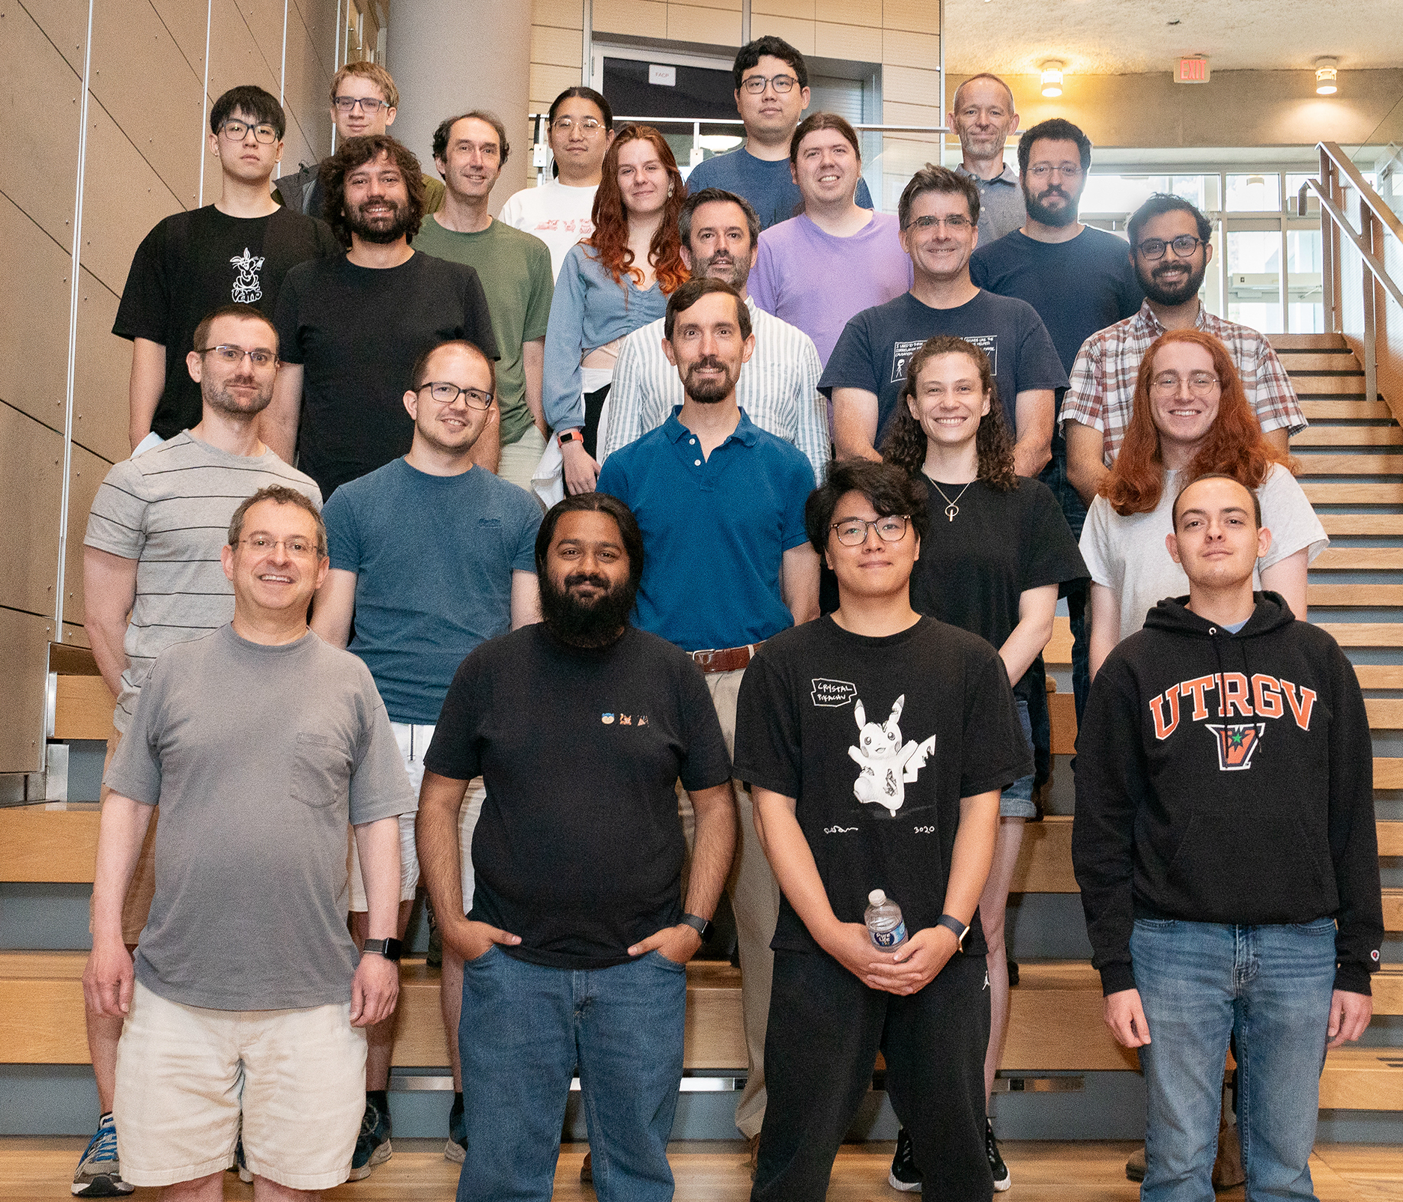

Verification & Rust: Advanced Topics
Travis Hance (and the Verus Team)
CMU
MPI-SWS (to join soon)
https://verus.rs/

Slide 2
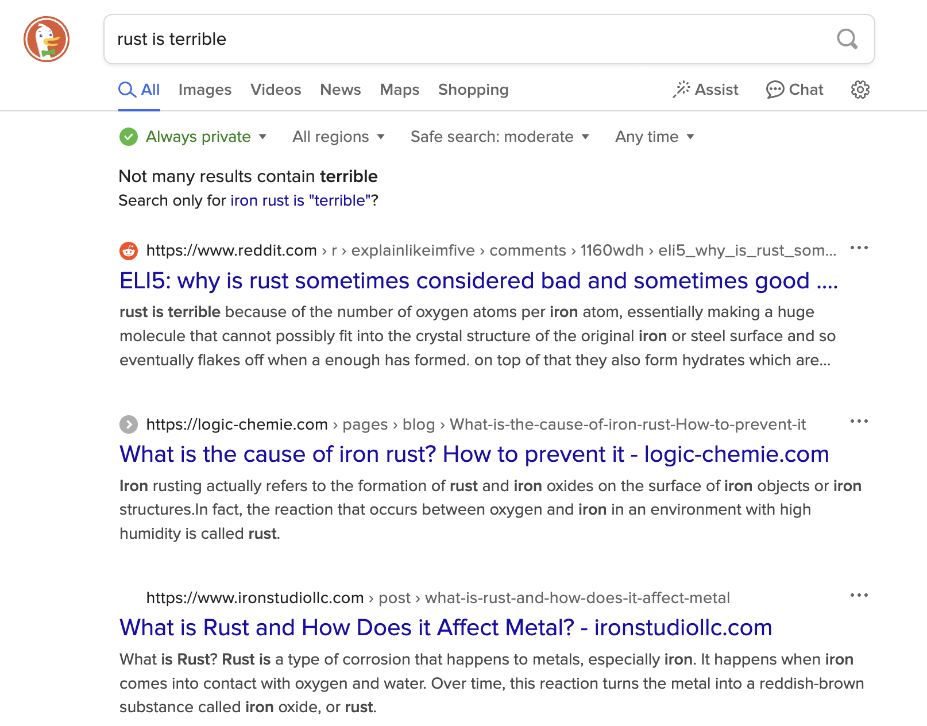
Rust has a lot of restrictions
I’m always fighting the borrow-checker!
Why can’t the compiler get out of my way?
Notes:
Rust is widely known to have a lot of restrictions. These restrictions are actually pretty good for verification …
This morning, we stuck to those restrictions, and Verus works pretty well when you do
But there are ways to bend those restrictions …

Slide 3
Rust’s restrictions & verification
Rust is widely seen as having a lot of “restrictions”
These restrictions are actually good for verification! When you stick to the well-trodden path, verification is often efficient and relatively painless
But these restrictions can be bent.

Slide 4
The well-trodden path
fn example(x: &mut u64, y: &mut u64) {
*x = *x + *y;
*y = *y / *x;
}
fn example2(x: u64, y: u64) -> (u64, u64) {
return (x + y, y / (x + y));
}
Rust’s reference system lets us make substantial simplifying assumptions
≈

Slide 5
The road less travelled
Head Tail

Slide 6
The road less travelled
Head Tail
This node has 2 “parents”

Slide 7
Rules are bent, not broken
There are still lines you can’t cross …
But you can do a lot in here.

Slide 8

Unsafe Code
Interior mutability
Notes:
I’m going to be talking about 3 big topics today – interior mutability, unsafe code, and concurrency
[poll audience if they know what interior mutability, unsafe code are]
These 3 topics are actually highly interrelated, in that any code using 1 of them is very likely using 1 of the others as well. To verify significant systems requires us to be proficient in the art of composing all the related concepts. For this talk, though, I’ll try to distill each to its essence and a present a self-contained introduction to each, at least for the first 2.

Slide 9
Unsafe Code

Slide 10

What is unsafe code?
Definition attempt #1:
Unsafe code is code that opts the programmer out of the memory-safety guaranteed by Rust’s type system
fn oh_no() {
let p: *mut u64 = std::ptr::null_mut();
unsafe {
*p = 20;
}
}

Slide 11
What is unsafe code?
Definition attempt #1:
Unsafe code is code that opts the programmer out of the memory-safety guaranteed by Rust’s type system
fn oh_no() {
let p: *mut u64 = std::ptr::null_mut();
unsafe {
*p = 20;
}
}
This seems pretty bad — doesn’t Verus rely on this?

Slide 12

Let’s think a little more positively

Slide 13
What is unsafe code?
Definition attempt #2:
Unsafe code is code that has additional requirements (beyond Rust’s type checker) to guarantee memory safety

Slide 14
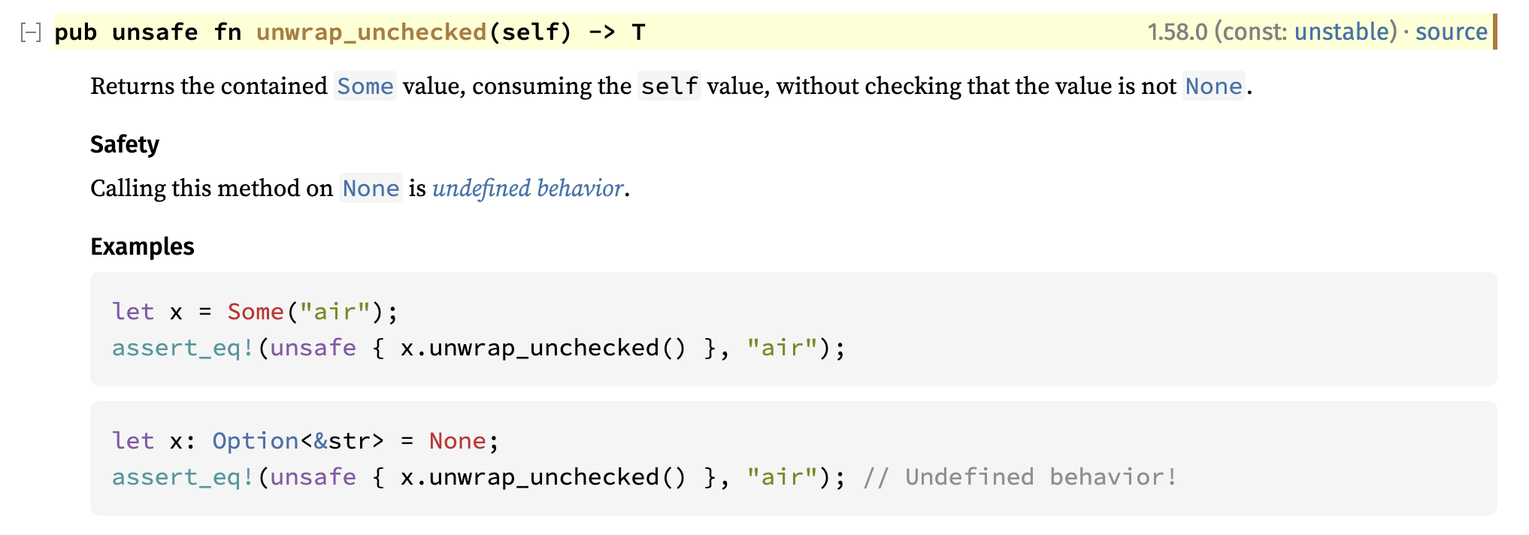
Example: Option::unwrap_unchecked
The subtext here is that behavior is defined if self is Some(_)
https://doc.rust-lang.org/std/option/enum.Option.html#method.unwrap_unchecked

Slide 15
What is unsafe code?
Unsafe code is really Conditionally Safe code — if the condition is satisfied, then it is safe
impl<T> Option<T> {
fn unwrap_unchecked(self) -> (res: T)
requires self.is_some()
ensures self == Some(res)
{
/* ... */
}
}
These conditions can be made explicit and formal using Verus preconditions

Slide 16
Unsafe Code

Slide 17

Unsafe Code
Notes:
Put this way, unsafe code doesn’t sound so bad. “Unsafe code” just means it has a requires clause, which is what you all have been practicing with all day. But —

Slide 18

Unsafe pointers

Slide 19
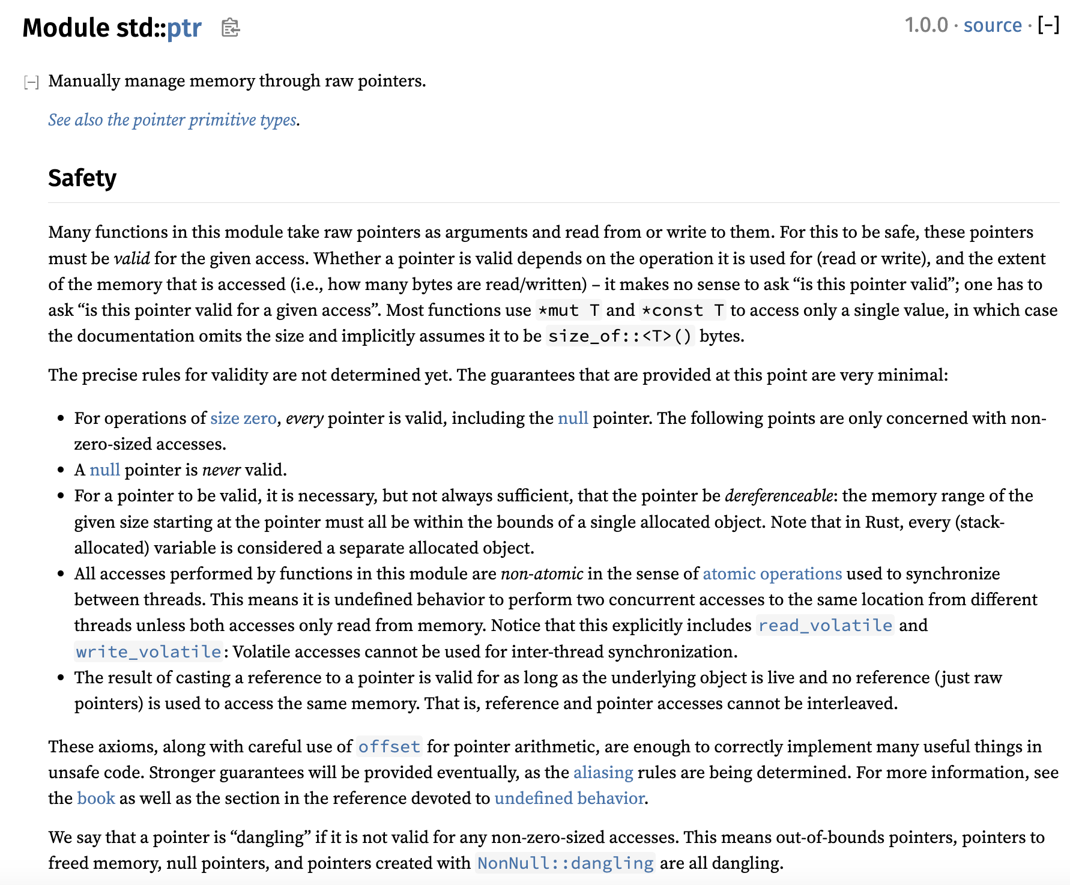
Let’s check the docs again

Slide 20
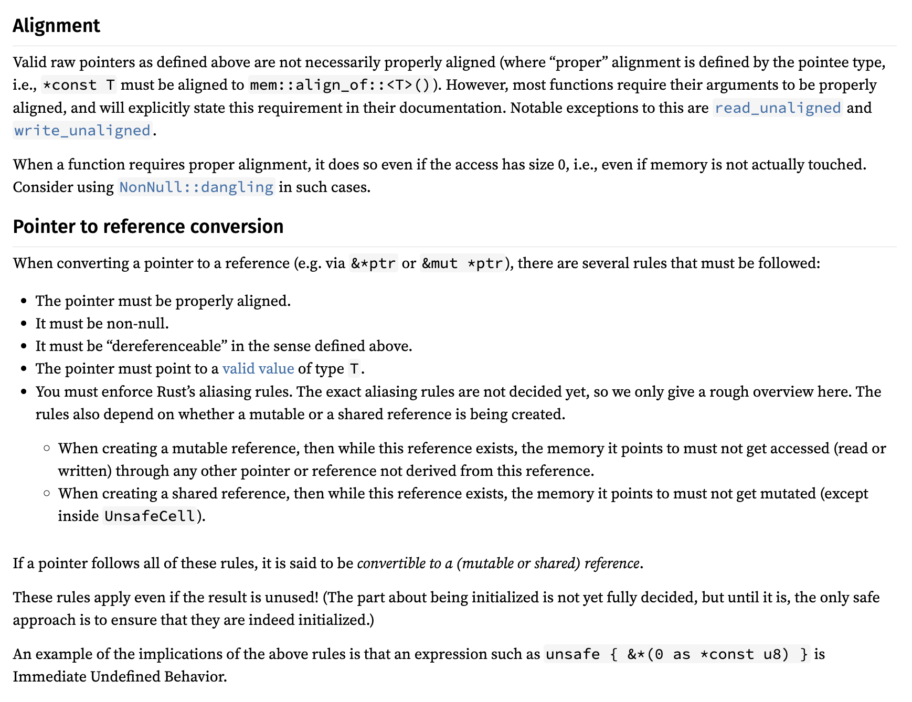
Let’s check the docs again

Slide 21
Let’s check the docs again
It keeps going, by the way

Slide 22
Pointers have a lot of conditions
Accessing a pointer requires:
Memory is valid, allocated, well-aligned
Reads must be initialized
Accesses are data-race-free
Playing nice with reference system (&T and &mut T)
Handling “pointer provenance”
Can these conditions even be expressed via Verus preconditions?

Slide 23

Isn’t this what ownership types are for?
Ordinarily, Rust’s type system, together with its clever standard library types (&T, &mut T, Box<T>, Rc<T>, Arc<T>, RefCell<T>, …), ensure that all the rules are followed
But the whole point of using “raw pointers” is that we can’t use those types…
Now we’re just going in circles!
Notes:
The point is that Rust does have the capability to cleanly reason about these concepts, it’s just slightly out of reach. We need to grasp a little farther.

Slide 24
Isn’t this what ownership types are for?
Ordinarily, Rust’s type system, together with its clever standard library types (&T, &mut T, Box<T>, Rc<T>, Arc<T>, RefCell<T>, …), ensure that all the rules are followed
But the whole point of using “raw pointers” is that we can’t use those types…
Solution: Decouple the ownership reasoning from the physical pointers; reason about ownership in “proof code”

Slide 25
Pointers have a lot of conditions
Accessing a pointer requires:
Memory is valid, allocated, well-aligned
Reads must be initialized
Accesses are data-race-free
Place nice with reference system (&T and &mut T)
Handling “pointer provenance”
For the demo & exercise, we’ll use Verus’s “Simple PPtr” library, which sands down the rougher edges at the cost of generality — but it still covers the key points

Slide 26
[PPtr demo]

Slide 27
Recap
In general, “unsafe code” is actually Conditionally Safe
i.e., it has a requires clause
However, for advanced cases like raw pointers, safety comes from a combination of this requires clause with complex ownership reasoning
We can handle this ownership reasoning in proof code, without tying it to the physical types

Slide 28
Summary
Safety ensured by preconditions
Safety ensured by ownership types
&mut T
Option::unwrap_unchecked
&T
Raw ptrs
Box<T>
Arc<T>
Rc<T>
“Unsafe code”
“Safe code”

Slide 29
Interior mutability

Slide 30

What is interior mutability?
Rust’s references are usually described to new users as follows:
Type
&mut T | Unique | Mutable
&T | Shared | Immutable
Unfortunately it’s not entirely correct …
Sometimes described as “shared XOR mutable,” this is an important property that enables Rust’s memory safety & Verus’s efficient SMT encoding

Slide 31
What is interior mutability?
Interior mutability is a pattern wherein you can modify data behind a shared reference (&).
However, this is only possible through specialized “interior mutability” types (e.g., Cell, RefCell, Mutex, RwLock, UnsafeCell)
This is good, because unrestricted mutation-through-& would ruin all the theory behind Verus’s encoding
As it is, we can restrict the additional complexity only to when these specialized types are involved

Slide 32
What’s the problem?
fn example(cell1: &Cell<u64>, cell2: &Cell<u64>)
-> (u64, u64)
{
cell1.set(24);
cell2.set(25);
let x = cell1.get();
let y = cell2.get();
(x, y)
}
cell1 = 24
cell2 = 25
x = 24
y = 25
(x, y) = (24, 25)
Notes:
This is obviously wrong … if it seems laughably naïve to you, though, I want to emphasize that this is basically how Verus works 90% of the time, when you’re working with “normal” reference types

Slide 33
What’s the problem?
fn example(cell1: &Cell<u64>, cell2: &Cell<u64>)
-> (u64, u64)
{
cell1.set(24);
cell2.set(25);
let x = cell1.get();
let y = cell2.get();
(x, y)
}
cell1 = 24
cell2 = 25
x = 24
y = 25
But (25, 25) is possible!
(x, y) = (24, 25)
Notes:
This is obviously wrong … if it seems laughably naïve to you, though, I want to emphasize that this is basically how Verus works 90% of the time, when you’re working with “normal” reference types

Slide 34
What’s the problem?
fn example(cell1: &Cell<u64>, cell2: &Cell<u64>)
-> (u64, u64)
{
cell1.set(24);
cell2.set(25);
let x = cell1.get();
let y = cell2.get();
(x, y)
}
Option 1: Maintain a “cell heap”
Heap = [ cell1 |--> 24 ; cell2 |--> 25 ]
(and cell1 ≠ cell2)
Or
Heap = [ cell1 |--> 25]
(and cell1 = cell2)
This “leaks” the mutability everywhere
Notes:
This is obviously wrong … if it seems laughably naïve to you, though, I want to emphasize that this is basically how Verus works 90% of the time, when you’re working with “normal” reference types

Slide 35

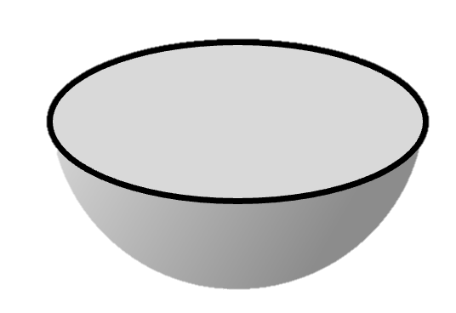
We’d prefer to encapsulate mutation
The whole point of interior mutability is to “pretend” that something mutable is immutable.
Verification should reflect that.
&mut T
Let’s do an example to see why we care

Slide 36
Example: Memoizing a deterministic fn
Suppose we have some expensive but deterministic computation
pub fn expensive_function(args: &Args) -> Output {
/* ... */
}
struct Memoizer {
map: HashMap<Args, Output>
}
impl Memoizer {
pub fn get(&mut self, args: &Args) -> Output {
match self.map.get(args) {
Some(result) => result.clone(),
None => {
// Compute for the first time and store the result for next time
let result = expensive_function(args);
self.map.insert(args.clone(), result.clone());
result
}
}
}
}
We can memoize the results — lazily populate a lookup-table of results, as-needed

Slide 37
Example: Memoizing a deterministic fn
Now, what if we want to share the Memoizer across multiple subsystems? Maybe even across threads?
Arc<Memoizer> → &Memoizer
Whoops, now we can’t call get —
fn get(&mut self, args: &Args)

Slide 38
Example: Memoizing a deterministic fn
pub fn expensive_function(args: &Args) -> Output {
/* ... */
}
struct Memoizer {
map: HashMap<Args, Output>
}
impl Memoizer {
pub fn get(&mut self, args: &Args) -> Output {
match self.map.get(args) {
Some(result) => result.clone(),
None => {
// Compute for the first time and store the result for next time
let result = expensive_function(args);
self.map.insert(args.clone(), result.clone());
result
}
}
}
}

Slide 39
Example: Memoizing a deterministic fn
We really want to implement this instead:
fn get(&self, args: &Args)
For this we can use interior mutability …

Slide 40
Example: Memoizing a deterministic fn
pub fn expensive_function(args: &Args) -> Output {
/* ... */
}
struct Memoizer {
ref_cell: RefCell<HashMap<Args, Output>>
}
impl Memoizer {
pub fn get(&self, args: &Args) -> Output {
let map_handle = self.ref_cell.borrow_mut();
match map_handle.get(args) {
Some(result) => result.clone(), None => {
// Compute for the first time and store the result for next time
let result = expensive_function(args);
map_handle.insert(args.clone(), result.clone());
result
}
}
}
}

Slide 41
Example: Memoizing a deterministic fn
Now we have this beautiful type signature that hides the mutability:
fn get(&self, args: &Args)
The Verus specification should be equally concise:
no “modifies” clause
no passing in “write-permissions”
etc.
&mut T

Slide 42
Solution: What doesn’t change?
If Verus can’t treat like &Cell<u64> as a u64 because the u64 might change … let’s treat it like something that doesn’t change
What doesn’t change? An invariant.
Bonus: Invariants work well with locks, too.

Slide 43
What’s the problem?
cell1 == 24 || cell1 == 25
cell2 == 25 || cell2 == 26
fn example(cell1: &Cell<u64>, cell2: &Cell<u64>)
-> (u64, u64)
{
cell1.set(24);
cell2.set(25);
let x = cell1.get();
let y = cell2.get();
(x, y)
}
cell1 == 24 || cell1 == 25
cell2 == 25 || cell2 == 26
x == 24 || x == 25
y == 25 || y == 26
Notes:
This is obviously wrong … if it seems laughably naïve to you, though, I want to emphasize that this is basically how Verus works 90% of the time, when you’re working with “normal” reference types

Slide 44
Interior mutability types
Cell
RefCell
Mutex
RwLock

Slide 45
Interior mutability types
Cell
RefCell
Mutex
RwLock
For single-threaded use

Slide 46
Interior mutability types
Cell
RefCell
Mutex
RwLock
For single-threaded use
Thread-safe; for multi-threaded use
There’s a spectrum of trade-offs in terms of overhead / flexibility

Slide 47
[RwLock demo]

Slide 48
An encapsulating specification
pub spec fn func(args: &Args) -> Output { ... }
pub fn expensive_function(args: &Args) -> (output: Output)
ensures output == func(args)
{ ... }
impl Memoizer {
pub fn get(&self, args: &Args) -> (output: Output)
ensures output == func(args)
{ ... }
}
Function must be deterministic
Memoizer is deterministic and computes the same function

Slide 49
An encapsulating specification
pub spec fn func(args: &Args) -> Output { ... }
pub fn expensive_function(args: &Args) -> (output: Output)
ensures output == func(args)
{ ... }
impl Memoizer {
pub fn get(&self, args: &Args) -> (output: Output)
ensures output == func(args)
{ ... }
}
Function must be deterministic
Memoizer is deterministic and computes the same function
Observe again how the mutation is encapsulated

Slide 50
Recap
Interior mutability carves an exception to the usual “sharing XOR mutability” dichotomy of Rust, which Verus relies on
Thus, interior mutability adds complexity, but that complexity can be encapsulated
To do this, we can use lock invariants / cell invariants

Slide 51
Notes:
Rope font is from: https://www.fontspace.com/category/rope

Slide 52
We already covered locks actually …
But one big global lock does not concurrency make!
Notes:
A global lock is _multi-threaded_ but it isn’t truly concurrent.

Slide 53
Realistic systems use fine-grained locks

Slide 54
Problem: split ownership
True Concurrency requires us to have multiple components that can be owned and operated independently
Problem: How do we reason about the system if we don’t have ownership of the whole thing?

Slide 55
Problem: split ownership
True Concurrency requires us to have multiple components that can be owned and operated independently
Problem: How do we reason about the system if we don’t have ownership of the whole thing?
On one hand, we can talk about the invariant on a single lock …

Slide 56
Problem: split ownership
True Concurrency requires us to have multiple components that can be owned and operated independently
Problem: How do we reason about the system if we don’t have ownership of the whole thing?
On one hand, we can talk about the invariant on a single lock …
But how do we relate them all together?

Slide 57
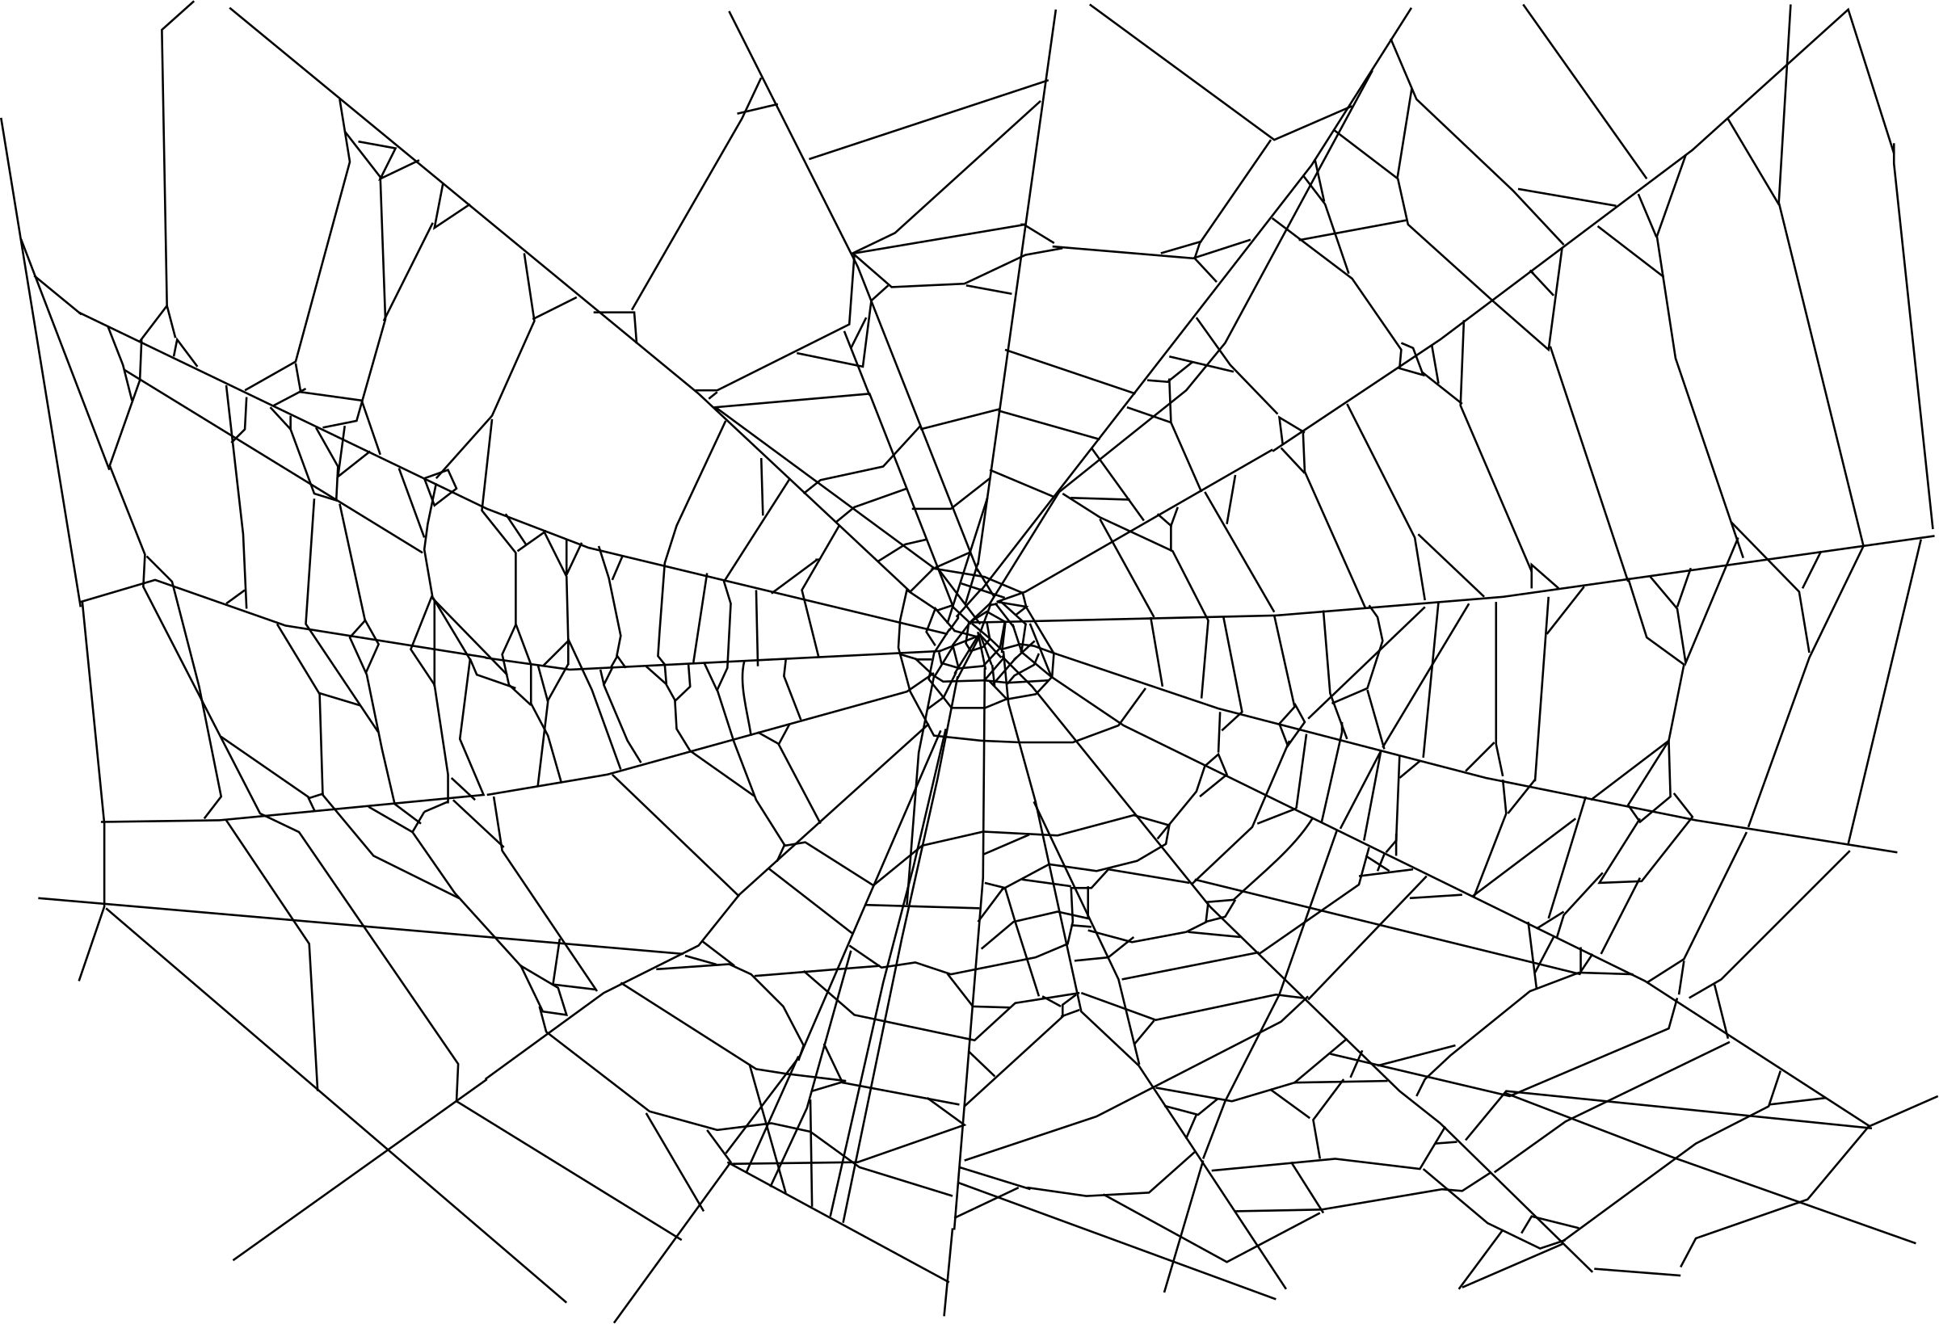
Problem: split ownership
True Concurrency requires us to have multiple components that can be owned and operated independently
Problem: How do we reason about the system if we don’t have ownership of the whole thing?
We need an invariant that “reaches across space”

Slide 58
Problem: split ownership
True Concurrency requires us to have multiple components that can be owned and operated independently
Problem: How do we reason about the system if we don’t have ownership of the whole thing?

Slide 59
Realistic systems use fine-grained locks

Slide 60
Realistic systems use fine-grained locks
We can talk about the invariant on a single lock

Slide 61
Realistic systems use fine-grained locks
We can talk about the invariant on a single lock
But how do we relate all the locks together?

Slide 62
But how do we reason globally?
We need an invariant that “reaches across space”

Slide 63
Example 2: Producer/consumer queue
Thread 1
Thread 2
Thread 3
Thread 4
Producer
Producer
Producer
Producer
Queue data is shared
Queue Buffer
Consumer
Consumer
Consumer
Consumer
Thread 5
Thread 6
Thread 7
Thread 8
Individual “handles” are owned by threads
9 separately owned objects that need to coordinate somehow …

Slide 64
Example 2: Producer/consumer queue
Thread 1
Thread 2
Thread 3
Thread 4
Producer
Producer
Producer
Producer
Queue data is shared
Queue Buffer
Consumer
Consumer
Consumer
Consumer
Thread 5
Thread 6
Thread 7
Thread 8
Individual “handles” are owned by threads
9 separately owned objects that need to coordinate somehow …

Slide 65
Example 2: Producer/consumer queue
Producer
Producer
Producer
Producer
Queue Buffer
Consumer
Consumer
Consumer
Consumer

Slide 66
Example 2: Producer/consumer queue
Thread 1
Producer
Thread 2
Consumer
Shared across threads:
Thread 3
Producer
Thread 4
Producer
Arc<
>
Queue Buffer
Thread 5
Producer
Thread 6
Consumer
Thread 7
Consumer
Thread 8
Consumer

Slide 67
Example 2: Producer/consumer queue
Thread 1
Thread 2
Thread 3
Thread 4
Producer
Producer
Producer
Producer
Queue Buffer
Consumer
Consumer
Consumer
Consumer
Thread 5
Thread 6
Thread 7
Thread 8

Slide 68
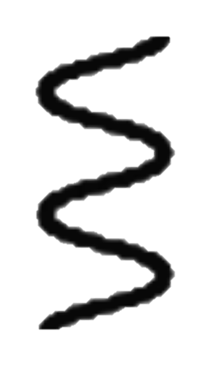
Example 2: Producer/consumer queue
Producer
Consumer
Shared across threads:
Producer
Producer
Arc<
>
Queue Buffer
Producer
Consumer
Consumer
Consumer

Slide 69
Example 2: Producer/consumer queue
Thread 1
Thread 2
Thread 3
Thread 4
Producer
Producer
Producer
Producer
Queue data is shared
Queue Buffer
Consumer
Consumer
Consumer
Consumer
Thread 5
Thread 6
Thread 7
Thread 8
Individual “handles” are owned by threads
9 separately owned objects that need to coordinate somehow …

Slide 72
Example 2: Producer/consumer queue
Thread 1
Thread 2
Thread 3
Thread 4
These components, owned by different threads, need to coordinate somehow
Producer
Producer
Producer
Producer
Queue Buffer
Consumer
Consumer
Consumer
Consumer
Thread 5
Thread 6
Thread 7
Thread 8

Slide 73
Example 3: “Agreement”
fn update_pair(mut token0: Token,
mut token1: Token, new_value: u64
) -> (pair: (Token, Token))
requires token0.id == token1.id
ensures
pair.0.value == new_value,
pair.1.value == new_value,
pair.0.id == token0.id,
pair.1.id == token1.id,
{
token0.value = new_value;
token1.value = new_value;
(token0, token1)
}
fn validate_pair(token0: &Token, token1: &Token)
requires token0.id == token1.id
ensures token0.value == token1.value
{
/* ? */
}
struct Token {
id: Id,
value: u64
}
fn new_pair(value: u64) -> (pair: (Token, Token))
ensures
pair.0.id == pair.1.id,
pair.0.value == value,
pair.1.value == value,
{
let id = fresh_id();
(Token { id: id, value: value },
Token { id: id, value: value })
}

Slide 74
Example 3: “Agreement”
fn update_pair(mut token0: Token,
mut token1: Token, new_value: u64
) -> (pair: (Token, Token))
requires token0.id == token1.id
ensures
pair.0.value == new_value,
pair.1.value == new_value,
pair.0.id == token0.id,
pair.1.id == token1.id,
{
token0.value = new_value;
token1.value = new_value;
(token0, token1)
}
fn validate_pair(token0: &Token, token1: &Token)
requires token0.id == token1.id
ensures token0.value == token1.value
{
/* ? */
}
struct Token {
id: Id,
value: u64
}
fn new_pair(value: u64) -> (pair: (Token, Token))
ensures
pair.0.id == pair.1.id,
pair.0.value == value,
pair.1.value == value,
{
let id = fresh_id();
(Token { id: id, value: value },
Token { id: id, value: value })
}

Slide 75
Example 3: “Agreement”
fn update_pair(mut token0: Token,
mut token1: Token, new_value: u64
) -> (pair: (Token, Token))
requires token0.id == token1.id
ensures
pair.0.value == new_value,
pair.1.value == new_value,
pair.0.id == token0.id,
pair.1.id == token1.id,
{
token0.value = new_value;
token1.value = new_value;
(token0, token1)
}
fn validate_pair(token0: &Token, token1: &Token)
requires token0.id == token1.id
ensures token0.value == token1.value
{
/* ? */
}
struct Token {
id: Id,
value: u64
}
fn new_pair(value: u64) -> (pair: (Token, Token))
ensures
pair.0.id == pair.1.id,
pair.0.value == value,
pair.1.value == value,
{
let id = fresh_id();
(Token { id: id, value: value },
Token { id: id, value: value })
}

Slide 76
Example 3: “Agreement”
fn update_pair(mut token0: Token,
mut token1: Token, new_value: u64
) -> (pair: (Token, Token))
requires token0.id == token1.id
ensures
pair.0.value == new_value,
pair.1.value == new_value,
pair.0.id == token0.id,
pair.1.id == token1.id,
{
token0.value = new_value;
token1.value = new_value;
(token0, token1)
}
fn validate_pair(token0: &Token, token1: &Token)
requires token0.id == token1.id
ensures token0.value == token1.value
{
/* ? */
}
struct Token {
id: Id,
value: u64
}
fn new_pair(value: u64) -> (pair: (Token, Token))
ensures
pair.0.id == pair.1.id,
pair.0.value == value,
pair.1.value == value,
{
let id = fresh_id();
(Token { id: id, value: value },
Token { id: id, value: value })
}

Slide 77
Example 3: “Agreement”
fn update_pair(mut token0: Token,
mut token1: Token, new_value: u64
) -> (pair: (Token, Token))
requires token0.id == token1.id
ensures
pair.0.value == new_value,
pair.1.value == new_value,
pair.0.id == token0.id,
pair.1.id == token1.id,
{
token0.value = new_value;
token1.value = new_value;
(token0, token1)
}
fn validate_pair(token0: &Token, token1: &Token)
requires token0.id == token1.id
ensures token0.value == token1.value
{
/* ? */
}
struct Token {
id: Id,
value: u64
}
fn new_pair(value: u64) -> (pair: (Token, Token))
ensures
pair.0.id == pair.1.id,
pair.0.value == value,
pair.1.value == value,
{
let id = fresh_id();
(Token { id: id, value: value },
Token { id: id, value: value })
}

Slide 78
Example 3: “Agreement”
fn update_pair(mut token0: Token,
mut token1: Token, new_value: u64
) -> (pair: (Token, Token))
requires token0.id == token1.id
ensures
pair.0.value == new_value,
pair.1.value == new_value,
pair.0.id == token0.id,
pair.1.id == token1.id,
{
token0.value = new_value;
token1.value = new_value;
(token0, token1)
}
fn validate_pair(token0: &Token, token1: &Token)
requires token0.id == token1.id
ensures token0.value == token1.value
{
/* ? */
}
struct Token {
id: Id,
value: u64
}
fn new_pair(value: u64) -> (pair: (Token, Token))
ensures
pair.0.id == pair.1.id,
pair.0.value == value,
pair.1.value == value,
{
let id = fresh_id();
(Token { id: id, value: value },
Token { id: id, value: value })
}
Who maintains this invariant?

Slide 79
Verus’s System: VerusSync
Provides a means for “space-reaching invariants”
Acknowledges that real systems need invariants a little more complicated than two-party agreement.

Slide 80
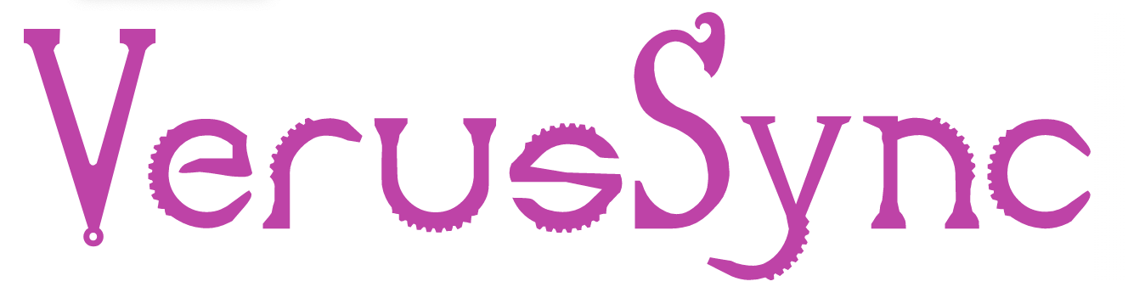
Verus’s System: VerusSync
VerusSync provides:
Ghost objects (like PointsTo)
Developer defines:
State
VerusSync
Operations
Invariants
With a space-reaching invariants

Slide 81
Verus’s System: VerusSync

Slide 82
Verus’s System: VerusSync
You can connect the ghost state to other state you care about via more lock invariants

Slide 83

Notes:
The space-reaching invariant reaches through the ”ghost dimension”

Slide 84
[Demo: VerusSync]

Slide 85

Recap
Memory permissions
Space-reaching invariants
Lock invariants

